Slide 1

Four Eagles Gold Project
A Virgin Gold Discovery in Victoria
13 September 2013
Bruce Kay
Technical
Director

Slide 2
Acknowledgements
Tom Burrowes, Providence Gold and Minerals Pty Ltd
Geoff Turner, Exploration Management Services, Bendigo, Victoria
Catalyst Shareholders

Slide 3
Presentation Summary
Location and History
Geology/Mineralisation
Bendigo Comparison
Future Programme
Conclusion

Slide 4
Bendigo / Ballarat Gold Zones
DPI predicts 32 million ounces of Gold under Cover
(source: Victorian Department of Primary Industries, Gold Undercover Initiative)
Historical Gold Production Bendigo-Ballarat Region

Slide 5
North Bendigo Gold Belt
Major gold belt emerging north of Bendigo
Totally concealed by Murray Basin sediments
Whitelaw Fault controls gold
Catalyst has 25km of strike length

Slide 6
Discovery History
03-08 Providence exploration drilling with little success (too far E and W)
2008 Victorian Govt releases gravity survey: shows regional Whitelaw Fault
09-10 Providence targets areas just west of Whitelaw Fault: Low grade gold
2010 Discovery Hole: 6metres @82.7g/t Au
11-13 Catalyst JV increases size of gold system to 6km ×2.5km with more gold zones

Slide 7
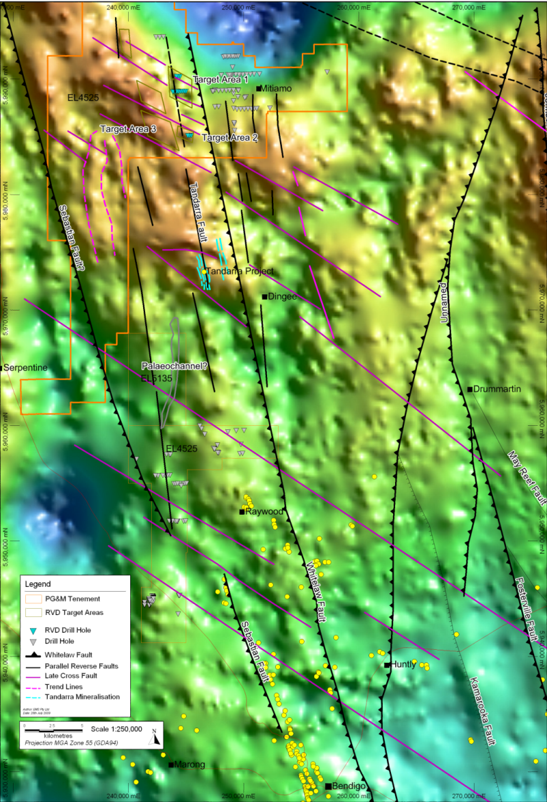
Targets – Gravity Interpretation
Geological survey of Victoria close spaced Bendigo-Mitiamo gravity data
Major faults interpreted
Tandarra mineralisation parallel to Whitelaw Fault
Tandarra on interpreted fault
Gravity highs used to select 2009 drilling targets

Slide 8
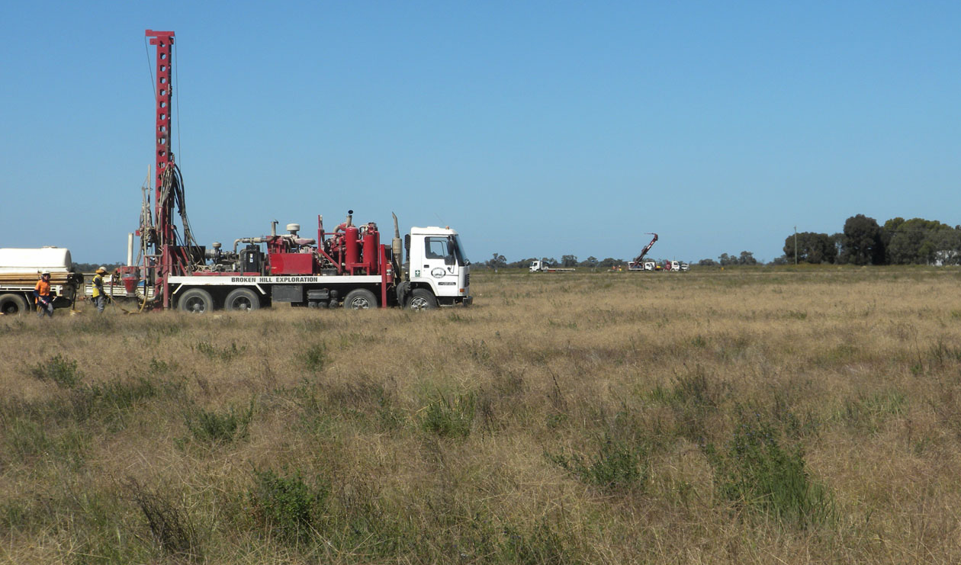
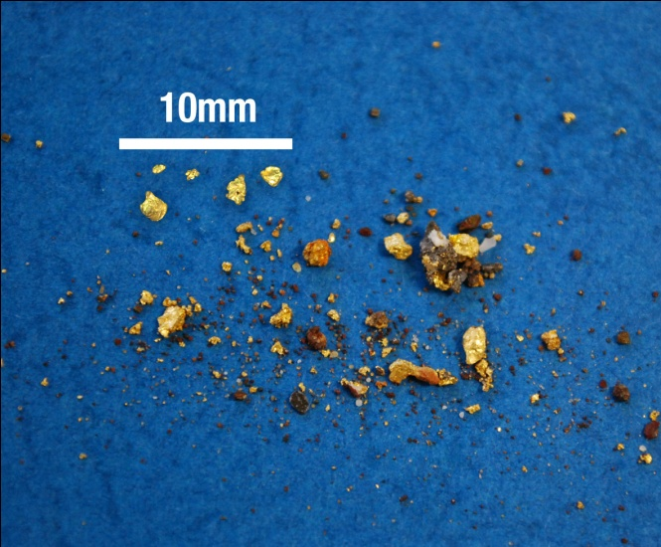
What lies beneath the wheat fields?
0.4m @ 152.0g/t Au (FEDD008)
6.0m @ 82.7g/t Au (FE328)
1.0m @ 18.3g/t Au (FERC002)
3.0m @ 36.6g/t Au (FE415)
1.0m @ 17.5g/t Au (FEDD001)
3.0m @ 20.5g/t Au (FE592)
3.0m @ 9.1g/t Au (FE608)

Slide 9
Four Eagles Gold Zones

Slide 10
Four Eagles: Summary
Large areas of gold potential in shallow basement
(< 50 metres)
Three structural Lines of Lode up to 10km long
Three prospects defined with high grades
Hayanmi Prospect now 2.6 kms long
Gold is finely divided with good assay repeatability
2013/14 Objective: Discovery of a large high grade gold deposit at shallow depth

Slide 11
Hayanmi Prospect

Slide 12
Hayanmi Trend

Slide 13
Hayanmi Cross Section

Slide 14
Boyd’s Dam Prospect

Slide 15
Discovery Prospect Cross Section

Slide 16
Bendigo: historic gold production
Historical gold production indicates:
Estimated 50,000 ounces per vertical metre
Every 100 metres contained 5 million ounces

Slide 17
Bendigo: a world-class gold target
Bendigo Goldfield
Historical Gold Production from Lines of Lodes
18 million ounces of
reef gold
4 million ounces of
alluvial gold
Includes possibly 7 million ounces in top 200 metres
Large footprint
(8kms x 3kms)

Slide 18
Four Eagles Gold Zones

Slide 19
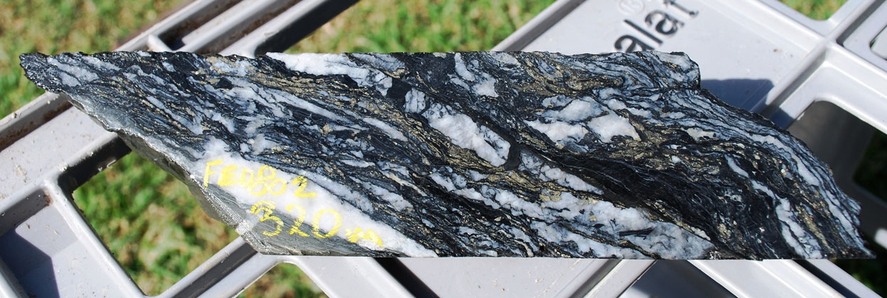
FEDD002 Drill Core
Typical Bendigo Laminated Quartz Vein

Slide 20
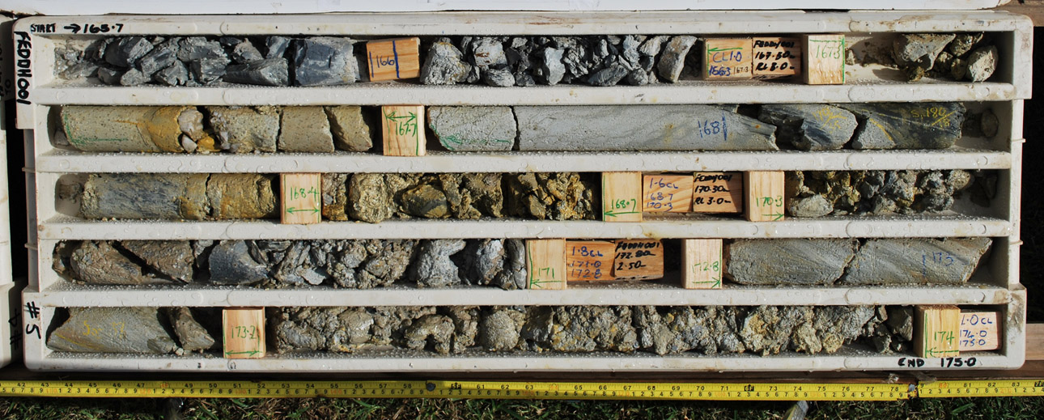
FEDD001 Drill Core
Tanderra Shear Zone intersected
0.7 metres @ 4.83g/t Au & 0.8 metres @ 17.5 g/t Au

Slide 21
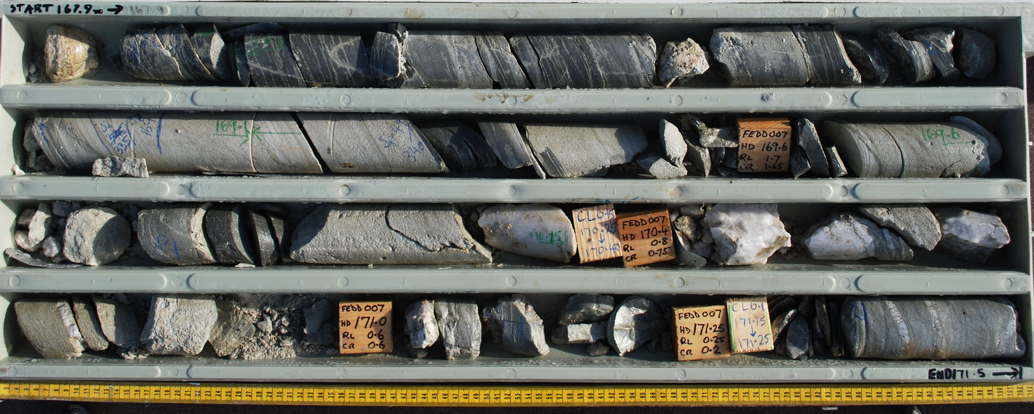
FEDD007 Drill Core
Strong zone of Shearing, Brecciation and Quartz Veinlets
0.4 metres @ 8.4 g/t Au & 0.75 metres @ 15.3 g/t Au

Slide 22
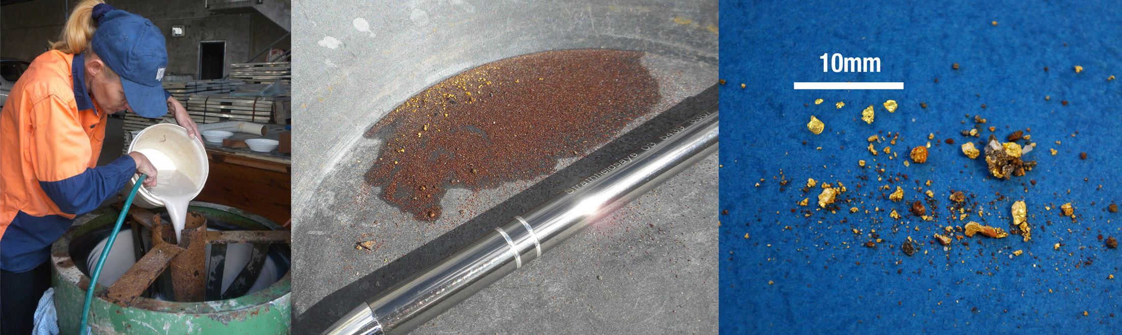
Four Eagles Fine and Coarse Gold
Gravity Processing (Knelsen and Pan) from Discovery (FE328), Hayanmi (FE471) and Boyd’s Dam (FE415)

Slide 23
LeachWELL Correlation Graph

Slide 24
Drilling Methodology

Slide 25
Four Eagles 2013/14 Drilling

Slide 26
Conclusion
Four Eagles confirmed as a virgin gold discovery under shallow cover
Large gold footprint with at least three gold zones
Similarities and differences compared to Bendigo
Project requires major angled drilling programme to test gold continuity

Slide 27
Competent Persons Statement
Competent Person’s Statement
The information in this report that relates to Exploration Results is based on information compiled by Mr Bruce Kay, who is a Fellow of the Australasian Institute of Mining and Metallurgy and is a non-executive director of Catalyst Metals Limited. Mr Kay has sufficient experience that is relevant to the style of mineralisation, type of deposit under consideration and to the activity that he is undertaking to qualify as a Competent Person as defined in the 2004 edition of the ‘Australasian Code for Reporting of Exploration, Results, Mineral Resource and Ore Reserves’. Mr Kay consents to the inclusion in this report of the matters based on his information in the form and context in which it appears.

Slide 28
Disclaimer and Forward Looking Statements
This presentation has been prepared by Catalyst Metals Limited (“Catalyst”). This document contains background information about Catalyst current at the date of this presentation. The presentation is in summary form and does not purport to be all inclusive or complete. Recipients should conduct their own investigations and perform their own analysis in order to satisfy themselves as to the accuracy and completeness of the information, statements and opinions contained in this presentation.
This presentation is for information purposes only. Neither this presentation nor the information in it constitutes an offer, invitation, solicitation or recommendation in relation to the purchase or sale of shares in any jurisdiction.
This presentation may not be distributed in any jurisdiction except in accordance with the legal requirements applicable in such jurisdictions. Recipients should inform themselves of the restrictions that apply in their own jurisdiction. A failure to do so may result in a violation of securities laws in such a jurisdiction.
This presentation does not constitute investment advice and has been prepared without taking into account the recipient’s investment objectives, financial circumstances or particular needs and the opinions and recommendations in this presentation are not intended to represent recommendations of particular investments to particular persons. Recipients should seek professional advice when deciding if an investment is appropriate. All securities transactions involve risks, which include (among others) the risk of adverse or unanticipated market, financial or political developments.
To the fullest extent permitted by law, Catalyst and its officers, employees, agents and advisers do not make any representation or warranty, express or implied, as to the currency, accuracy, reliability or completeness of any information, statements, opinions, estimates, forecasts or other representations contained in this presentation. No responsibility for any errors or omissions from this presentation arising out of negligence or otherwise is accepted.
This presentation may include forward looking statements. Forward looking statements are only predictions and are subject to risks, uncertainties and assumptions which are outside the control of Catalyst. Actual values, results or events may be materially different to those expressed or implied in this presentation. Given these uncertainties, recipients are cautioned not to place reliance on forward looking statements. Any forward looking statements in this presentation speak only at the date of issue of this presentation. Subject to any continuing obligations under any applicable law and the ASX Listing Rules, Catalyst does not undertake any obligation to update or revise any information or any of the forward looking statements in this presentation of any changes in events, conditions or circumstances on which any such forward looking statement is based.

Slide 29
Four Eagles Gold Project
A Virgin Gold Discovery in Victoria
13 September 2013
Bruce Kay
Technical
Director

